Slide 1
basic concept

Slide 2
disclosures
ppt is for training
aggressive and absolute statements/comments don't mean that they are 100% accurate
don't take all advises

Slide 3
not in scope
deep dive-in all kinds of algorithms
all kinds of java syntax (please read “thinking in java”)
detail error debugging

Slide 4
goal
enterprise applications
built for production code
best practices
focus on problem-resolving

Slide 5
when not java
to just test quick logic
using excel (VBA), browser(Javascript)
when everything is ready on an environment (e.g a web page)
one time effort and manual work is quicker (copy/paste, sorting, line/column edit etc)
it must be C#, Swift; it should be C++; Python is much easier...

Slide 6
ground rules
start form command-line
always with Unit Test
fast integration

Slide 7
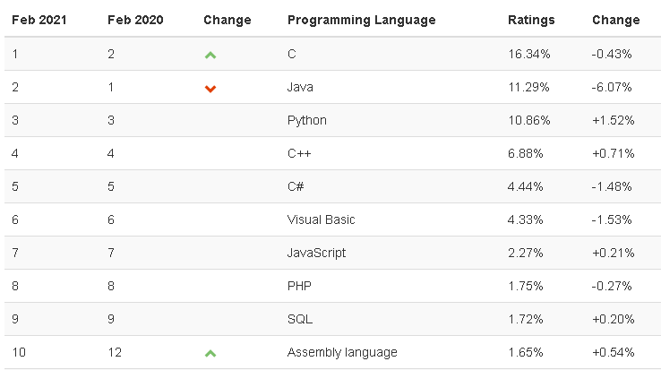
java now - TIOBE Index for February 2021
Notes:
https://www.tiobe.com/tiobe-index/

Slide 8
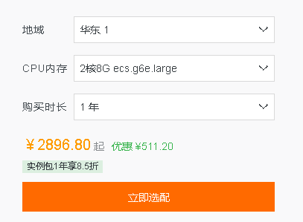
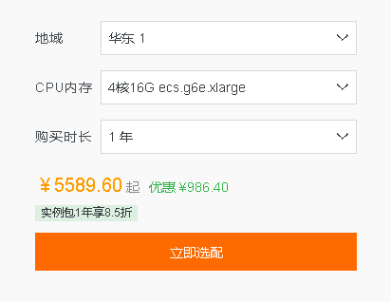
hardware price
It is not cheap but cheaper than software

Slide 9
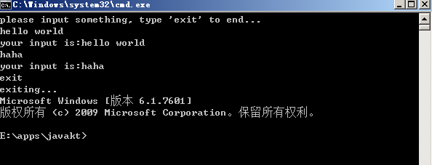
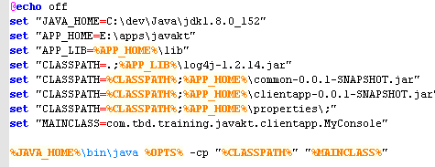
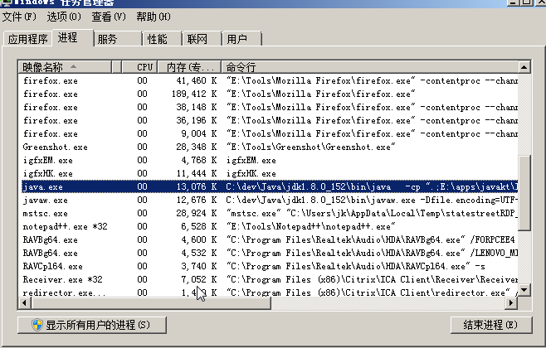
Try your first Java program - command line

Slide 10
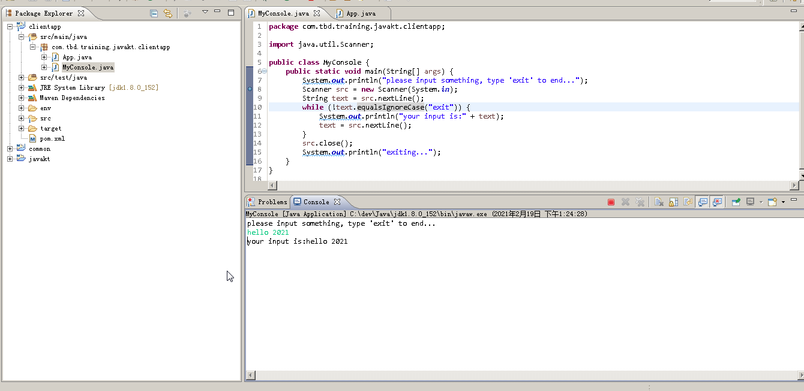
Try your first Java program - IDE

Slide 11
project structure, logging, properties, etc
maven
log4j
application properties
*utils

Slide 12
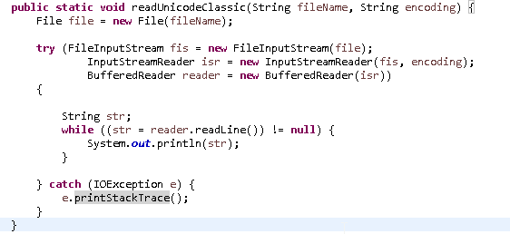
Java
steam
input --> stream ==> read
output --> steam ==> write

Slide 13
task - parse large file

